Slide 1
Homey

Slide 2
AGENDA
Description​
Target audience and area
​Handmade artboards
Challenges
Scenarios

Slide 3
Description
We are going to make a website to help people find a house to buy or lease and prepare their new houses with furniture all in one app, and make it easier for ordinary people to sell their old or new houses without having to use a middleman.

Slide 4
Area: Cairo Gender: males and females Age: 21+ Target audience: - people who are about to marry - people who are going independent - shop and apartments owners

Slide 5
Functionalities: - search for apartments. - filter apartments and furniture by buyer location or price. - lease or buy an apartment. - put an apartment up for selling or leasing. - users should by able to chat with sellers. - search for furniture and buy them. - sign up to the system to pay or put anything in the system for leasing or selling. - sign in to the system. - pay by credit card or cash. - refund if it was agreed on before making the transaction.

Slide 6
Handmade Artboards

Slide 7
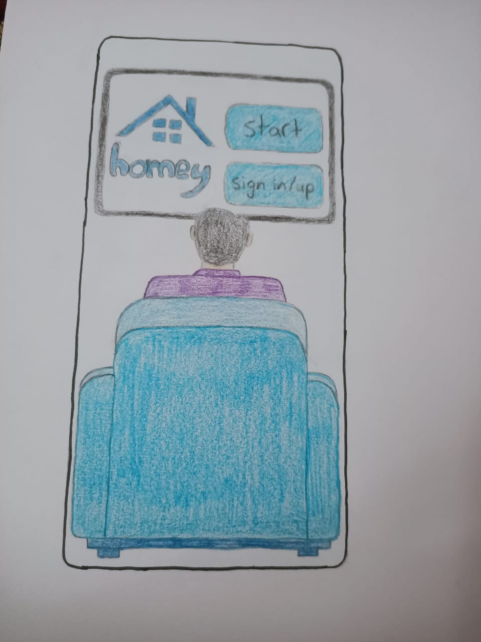
start up page

Slide 8
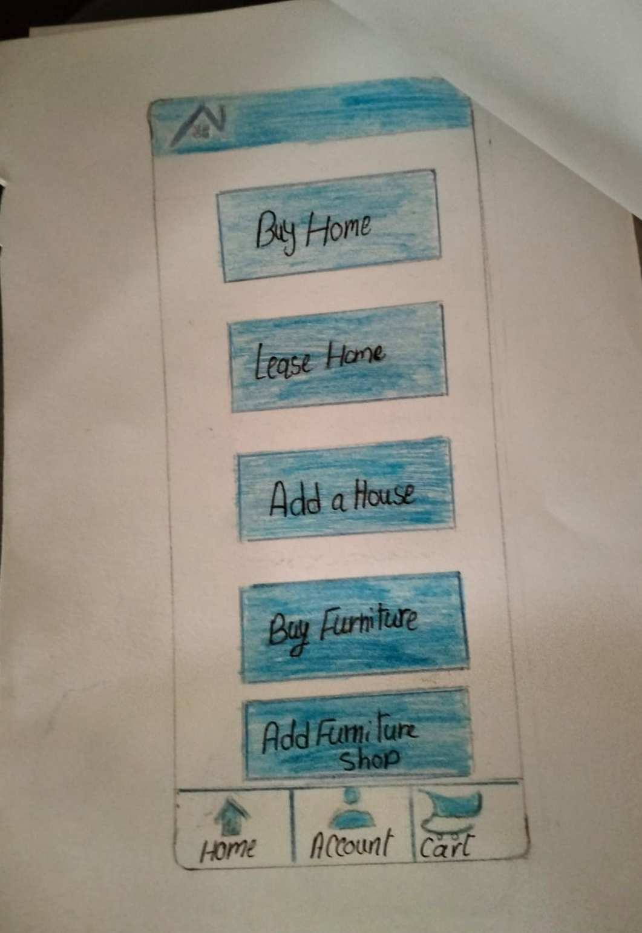
Home page

Slide 9
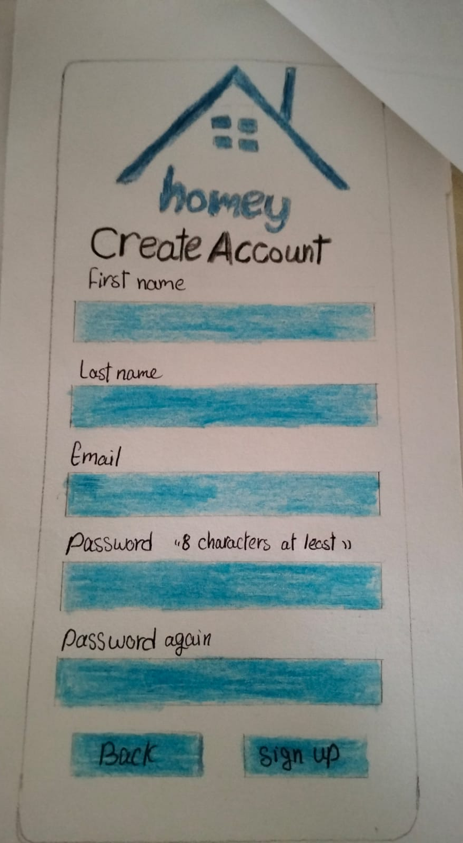
Sign up page

Slide 10
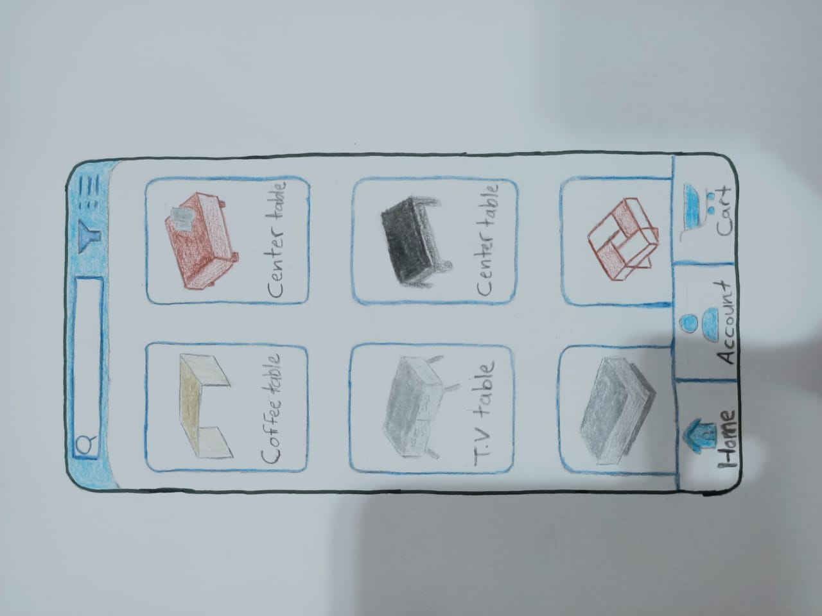
Products page

Slide 11
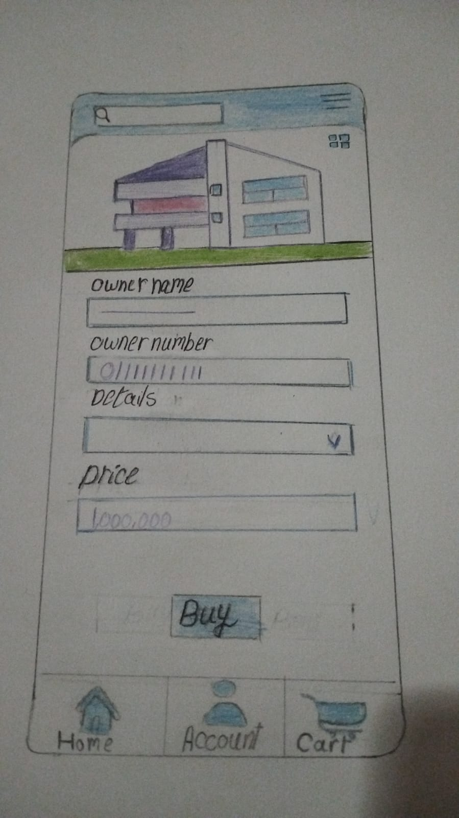
Product view page

Slide 12
Challenges
1.Using the pen tool.
2. Merging the XD files together.

Slide 13



HOW WE GET THERE
ROI
NICHE MARKETS
SUPPLY CHAINS
Envision multimedia-based expertise and cross-media growth strategies
Visualize quality intellectual capital
Engage worldwide methodologies with web-enabled technologies
Pursue scalable customer service through sustainable strategies
Engage top-line web services with cutting-edge deliverables
Cultivate one-to-one customer service with robust ideas
Maximize timely deliverables for real-time schemas

Slide 14
THANK YOU
Nada Osama Ahmed 20216108
Toqa Ahmed Moatez 20206012

